Slide 1
IPL MANAGEMENT SYSTEM

Slide 2

Team Members
161261 : Preetha Senthilkumar
161263 : Arnab Paul
161615 : Subhrodeep Das
161619 : Sravana Kalyani Jandhayala
161623 : Mohanapriya
161696 : Arnav Puri

Slide 3
Project Details
This project is aimed at developing a Windows application - IPL Management System(IPLMS) for managing details of Matches, Schedules, Players, News, and Results etc.
Technology used:
Presentation Layer
WPF 4.5
Business Layer
Business Logic Components and Services :-
C# 5.0
Database Layer
Databases:-
SQL Server 2012

Slide 4
SCOPE
This project is aimed at developing a WPF application for IPL.
The Indian Premier League (IPL), officially Vivo Indian Premier League for sponsorship reasons, is a professional Twenty20 cricket league in India contested during April and May of every year by teams representing Indian cities and some states.
This application will help BCCI to manage match Schedules, Results, Ticket Booking, News details and Customers to book match tickets and View News, Schedules, Result etc. of the matches.

Slide 5
Role of Employee
Add, Update, Delete, Search and List Teams.
Add, Update, Delete, Search and List Players of a Team.
Add, Update, Delete, Search and List Matches.
Add, Update, Delete, Search and List Schedule of Matches.
Add, Update, Delete, Search and List Venues.
Add, Update, Delete, Search and List Match Result.
Add, Update, Delete, Search and List Statistics.
Add, Update, Delete, Search and List Tickets.
Add, Update, Delete, Search and List Ticket Category.

Slide 6
Role of Customer
View Team and Player information.
View Ticket details and book Tickets for a particular match.
View Result of a Match.
View Statistics of matches played.
View News.
Role of Admin
Create and manage Users, Roles and assign Roles to Users

Slide 7
Design guidelines
All the exceptions/errors to be captured and user-friendly message to be displayed on the Windows.
Use WPF for Data access layer. Make use of stored procedures. All the database interaction would be performed using Data Access Component. Most common methods in Data Access Component would be :
Create Connection to the Database
Create Command Object
Set Command Type to Stored Procedure
Create and Populate Parameters
Execute the Command
Close the Connection

Slide 8
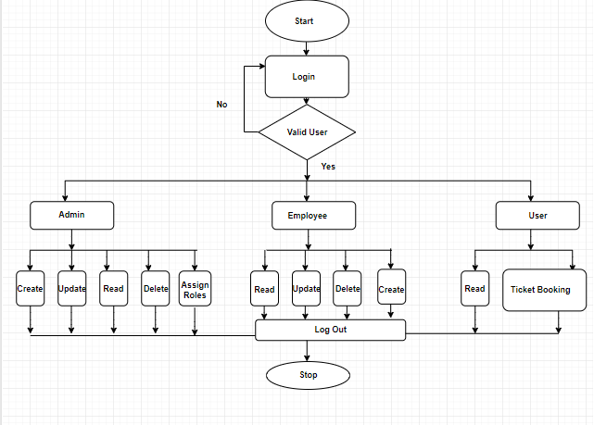
Sequence/Activity Diagram

Slide 9
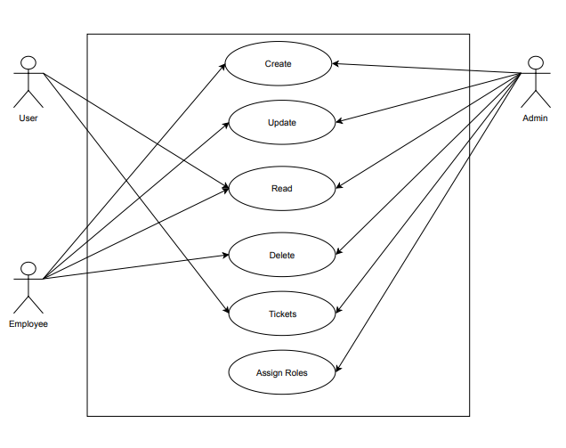
Use Case Diagram

Slide 10
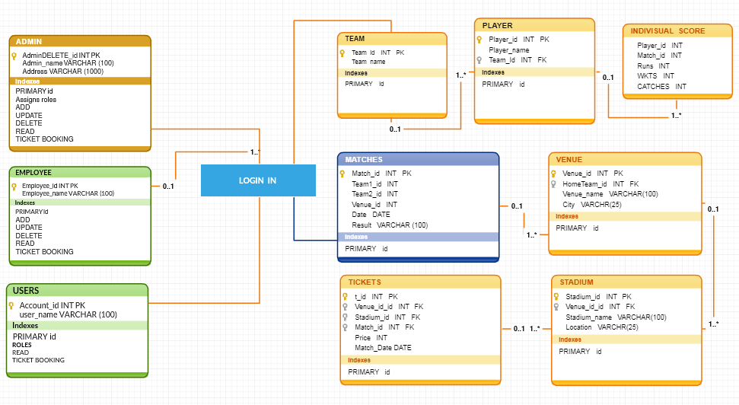
Class Diagram

Slide 11
Screen shots

Slide 12
Screen shots

Slide 13
Future Enhancements
Using ASP.NET MVC instead of WPF.
Implementing Search operation.
Ticket Booking.

Slide 14

Thanks

